Slide 1
CSE7101- Capstone Project Review-2
PROJECT TITLE – ASK YOUR VET
Batch Number: CSD-42
Under the Supervision of,
ROLL NUMBER | NAME
20221CSD0123 | RAJASHREE S
20221CSD0131 | SANATH M
20221CSD0148 | NIHA NAAZ
Mr. Himansu Sekhar Rout Assistant Professor
School of Computer Science and Engineering, Presidency University
Name of the Program: Computer Science and Engineering (Data Science) Name of the HoD: Dr. Pravithraja S
Name of the Program Project Coordinator: Dr. H M Manjula Name of the School Project Coordinators: Dr. Sampath A K, Dr. Geetha A

Slide 2
Contents
Abstract – Concise overview of problem, solution, and impact.
Problem Statement – Limited access, high costs, and lack of sports vet care.
Objectives – Goals for accessibility, affordability, and specialization.
Literature Survey – Review of studies on telemedicine, care, and sports health.
Existing Methods & Drawbacks – Current apps analyzed with key limitations.
Proposed Method & Feasibility Study – Approach, technology, and cost viability.
System Architecture – High-level flow of app, backend, and data handling.
Modules & Functionalities – Defined features for owners, vets, and admin.
Hardware & Software Details – Tools, frameworks, and devices used.

Slide 3
Contents
Timeline (Gantt Chart) – 5 phases covering research to deployment.
Expected Outcomes – Anticipated results and societal benefits.
GitHub – Repository link with code and resources
References – IEEE-style citations from research and case studies.

Slide 4
Abstract
This project presents a digital veterinary consultation platform designed to bridge the gap between pet owners and certified veterinarians, including specialists in animal sports health. The system integrates a mobile and web interface built with Flutter and React, connected to a Django backend with PostgreSQL for secure health records. Real-time communication is enabled via Firebase, while payments are handled through Razorpay, all deployed on cloud infrastructure with SSL/TLS security. The workflow ensures seamless user interaction, reliable data management, and accessible veterinary care, ultimately improving affordability, convenience, and animal welfare.

Slide 5
Problem Statement Number: PSCS_699 - SOFTWARE
Problem Description:
This problem invites the development of a novel solution leveraging digital technology to address societal or administrative challenges within public services, sustainability, or governance
.
Key Issues:
Limited Accessibility – Rural and remote areas lack veterinary services.
High Costs – Minor health concerns still require expensive in-person visits.
Scarcity of Specialists – Sports medicine vets for performance animals are very few.
Poor Record Management – No centralized digital health records for pets/animals.
Low Awareness – Owners lack knowledge on preventive care, nutrition, and training.
Time Delays – Long waiting times for consultations in urban clinics.
Regulatory Challenges – Telemedicine and prescription rules require careful compliance.

Slide 6
Objectives
Obj 1: Deliver affordable veterinary care through a simple digital platform.
Obj 2: Connect owners with licensed vets and sports specialists easily.
Obj 3: Maintain centralized digital health records for every animal.
Obj 4: Promote preventive care and nutrition awareness for all owners.
Obj 5: Ensure trust, safety, and compliance with telemedicine laws.
Obj 6: Build a scalable, user-friendly solution for urban and rural users.

Slide 7
Proposed Method & Feasibility Study
Feasibility and cost
Approach
Mobile + Web platform for pet owners, vets, and specialists.
Asynchronous Q&A (text/photo upload) + Real-time video consultations.
Centralized digital health records for pets (vaccinations, treatments, history).
Secure payments and reminders for preventive care.
Low initial cost: Open-source stack + cloud free tier for early stages.
Scalable: Can expand to handle more users as adoption grows.
Practicality: Leverages existing digital payment & telemedicine frameworks.
Pilot Ready: Suitable for limited-region rollout (e.g., Bengaluru + nearby).

Slide 8
Literature Survey Summary
GOOGLE DOCS LINK!

Slide 9
Gap Analysis & Innovation
Existing Limitation | Our Innovation
Limited vet access in rural/semi-urban areas | Digital telemedicine platform connecting owners with licensed vets
Scarcity of sports medicine specialists | Dedicated access to vets specializing in sports and performance animal care
No centralized animal health records | Unified digital health record system for pets and performance animals
High costs for minor consultations | Affordable online Q&A and triage before physical visits
Lack of preventive care awareness | Education modules on nutrition, vaccination, and training integrated in the platform
Fragmented pet apps (grooming/shopping focus) | End-to-end health + sports medicine + records platform
Poor continuity of care across clinics | Persistent digital history accessible to multiple vets
Regulatory uncertainty in telemedicine | Platform designed with compliance to VCI & data privacy laws

Slide 10
Current Apps and Drawbacks
Existing App | Drawbacks
PawPurrfect / Practo Pets | Focus mainly on appointment booking, limited rural reach.
PetDesk | Emphasizes reminders and scheduling, but no specialist/sports vet support.
Vetster | Offers online consults, but costs are high and not accessible to all regions.
Fuzzy Pet Health | Subscription-based, more nutrition/wellness tips than detailed medical care.
PetCoach (by Petco) | Community-driven Q&A; responses are often generic and not always from certified vets.
Our app fills the gap with affordability, rural access, and sports specialization.

Slide 11
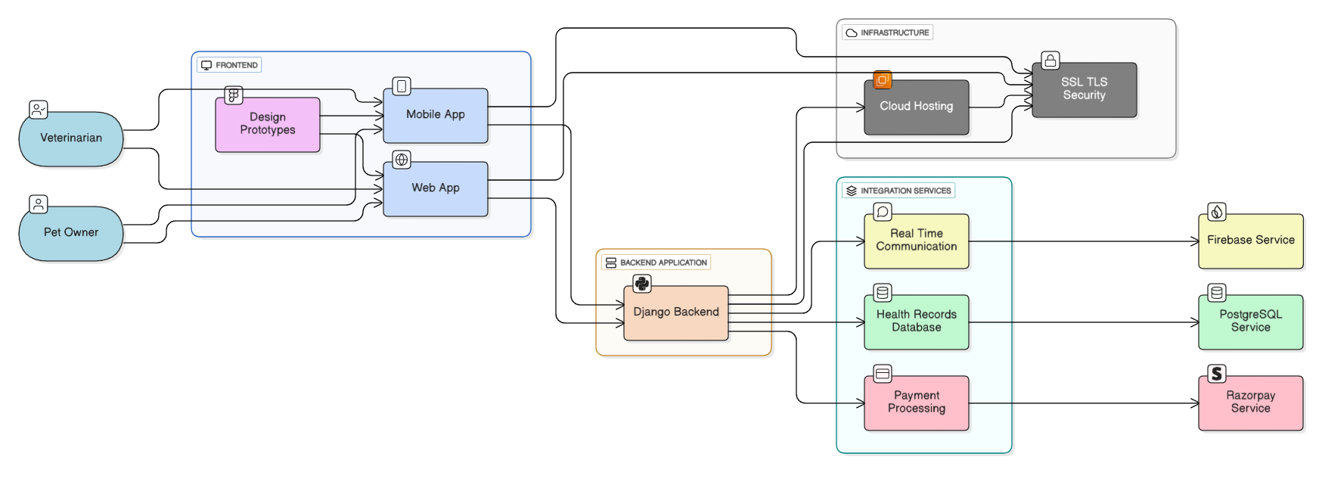
System Architecture

Slide 12
Hardware & Software Details
Category | Details
Frontend | Flutter (mobile), React.js (web)
Backend | Django (Python)
Database | PostgreSQL
Communication | Firebase (chat, notifications)
Payments | Razorpay
Deployment | Heroku / AWS (cloud hosting)
Design Tools | Figma
Security | SSL/TLS encryption
Development Hardware | Laptops/PCs (≥ i5, 8GB RAM)
Testing Devices | Android phone, iPhone, Tablet
Server Hardware | Cloud-hosted (Heroku/AWS free tier)

Slide 13
Modules & Functionalities
User Role | Modules | Key Functionalities
Owner (Pet Parents / Farmers / Trainers) | - Registration & Login - Pet Profile Management - Consultation (Text/Photo/Video) - Payments & Subscriptions - Notifications & Reminders | - Create/manage multiple pet profiles - Ask health & sports-related queries - Book and attend video calls - Pay securely via Razorpay - Get vaccination/treatment reminders
Veterinarian / Specialist | - Vet Profile & Verification - Consultation Management - Medical Records Update - Scheduling & Availability | - Verified profile with qualifications - Respond to owner queries (Q&A, video) - Update prescriptions & treatment notes - Set consultation hours/availability
Admin | - User & Vet Management - Data Security & Compliance - Payment Monitoring - Reporting & Analytics | - Approve/verify vets - Ensure data protection & telemedicine compliance - Monitor transactions & revenue - Generate usage and performance reports

Slide 14
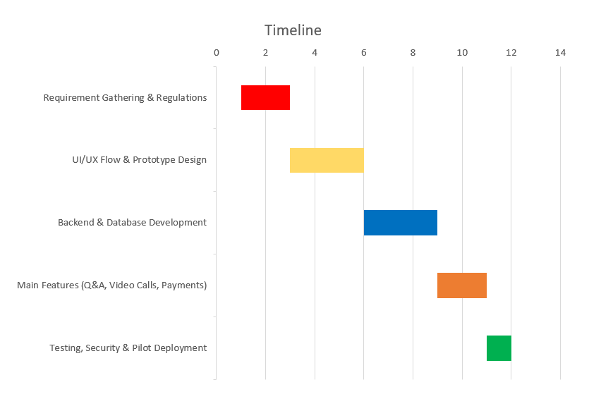
Timeline of the Project (Gantt Chart)
Phase 1 (Weeks 1-2): Focus on requirement gathering, defining scope (pets + sporting animals), and researching veterinary telemedicine regulations. Phase 2 (Weeks 3-5): Design user flow and develop prototype UI/UX for owner and vet interfaces. Phase 3 (Weeks 6-8): Build core backend and database for user/pet profiles, consultations, and digital health records. Phase 4 (Weeks 9-10): Implement main app features – Q&A, video consultations, notifications, and payment gateway. Phase 5 (Weeks 11-12): Testing, security checks, pilot deployment, and feedback collection for improvements.

Slide 15
Expected Outcomes
Easy and affordable access to licensed veterinarians.
Timely advice for minor and preventive health issues.
Specialized care for sporting and working animals.
Centralized digital health records for pets and livestock.
Increased awareness of nutrition, vaccination, and preventive care.
Reduced travel and consultation costs for owners.
Scalable solution that can expand across regions

Slide 16
Github Link
The GitHub repository provides public access to our project's source code, documentation, and development resources. You will find implementations of the mobile application, backend services, and database integration, along with setup instructions to run the system. The repository also includes API endpoints for consultations, health record management, and notification services. We welcome community contributions and feedback to enhance the platform and add future features like sports medicine modules and wearable integration
Github Link: https://github.com/SANATH00/CAPSTONE-PROJECT.git

Slide 17
References (IEEE Paper format)
[1] American Veterinary Medical Association, “Veterinary Telehealth: The Basics.” Available: https://www.avma.org/resources-tools/animal-health-and-welfare/telehealth-telemedicine-veterinary-practice/veterinary-telehealth-basics. [Accessed: Sep. 9, 2025].
[2] B. A. Albadrani, M. A. Abdel-Raheem, and M. I. Al-Farwachi, “Veterinary telemedicine: A new era for animal welfare,” Open Veterinary Journal, vol. 14, no. 4, Apr. 2024. [Full text]. Available: https://www.ncbi.nlm.nih.gov/pmc/articles/PMC11128645/.
[3] L. M. Teller, “Exploring the challenges and opportunities presented by veterinary telemedicine,” Vet. Rec., Sep. 2022. [PDF / PubMed]. Available: https://www.researchgate.net/publication/363420225_Exploring_the_challenges_and_opportunities_presented_by_veterinary_telemedicine.
[4] D. Levine, A. P. Markley, D. J. Marcellin-Little, and H. Reesink, “Editorial: Sports medicine and physical rehabilitation, volume III,” Frontiers in Veterinary Science, 2025. [Full text]. Available: https://pmc.ncbi.nlm.nih.gov/articles/PMC11880228/.
[5] T. Atalaia, J. Prazeres, J. Abrantes, and H. M. Clayton, “Equine Rehabilitation: A Scoping Review of the Literature,” Animals, vol. 11, no. 6, 2021. Available: https://www.mdpi.com/2076-2615/11/6/1508.

Slide 18
References (IEEE Paper format)
[6] D. S. Kronfeld, P. L. Ferrante, and D. Grandjean, “Optimal Nutrition for Athletic Performance, with Emphasis on Fat Adaptation in Dogs and Horses,” J. Nutr., vol. 124, no. 12, pp. 2745S–2753S, 1994. Available via PubMed: https://pubmed.ncbi.nlm.nih.gov/7996286/.
[7] T. L. Richards et al., “Effect of Total Starch and Resistant Starch in Commercial Extruded Dog Foods on Gastric Emptying in Siberian Huskies,” Animals, vol. 11, no. 10, p. 2928, 2021. Available: https://www.mdpi.com/2076-2615/11/10/2928.
[8] S. Burron et al., “Safety of Dietary Camelina Oil Supplementation in Healthy, Adult Dogs,” Animals, vol. 11, no. 9, p. 2603, 2021. Available: https://www.mdpi.com/2076-2615/11/9/2603.
[9] J. Atwal et al., “No Observed Adverse Effects on Health Were Detected in Adult Beagle Dogs When Fed a High-Calcium Diet for 40 Weeks,” Animals, vol. 11, no. 6, p. 1799, 2021. Full text (open access) available: https://pmc.ncbi.nlm.nih.gov/articles/PMC8234157/.
[10] C. Delsante et al., “An Online Survey of Pet Food Storage and Feeding Practices of Dog and Cat Owners,” Animals, vol. 11, no. 5, p. 1478, 2021. Available: https://www.mdpi.com/2076-2615/11/5/1478.

Slide 19


